Slide 1


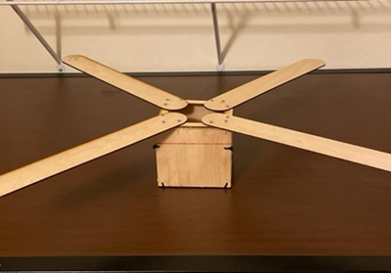
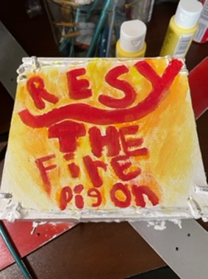
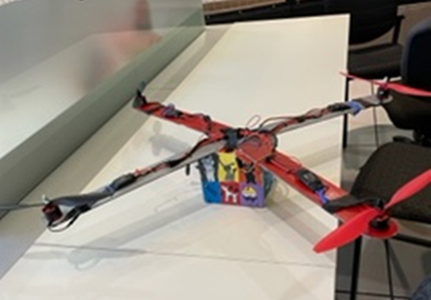
Resy the Fire pigeon
https://github.com/Wolfpanda01/drone-web-page
You can find us here
Do you want a custom design on a drone the resy the Fire pigeon the drone for you!
It is easy to maintain and very powerful
Its good for both beginners and experts
It has a custom design, 4 powerful motors, runs on an Arduino, esp32, and a MPU 6050

